Slide 1
ROPE

Slide 2
Many kinds of rope are in use today
Natural fibers: Hemp, Sisal, Manila, Coir, Cotton
Nylon
Polypropylene
Polyester (Dacron or Terylene)
Ultra-High molecular weight polyethylene (Spectra, Dynema, Vectran, Zylon)
Aramid (Kevlar, Twaron, Technora)

Slide 4
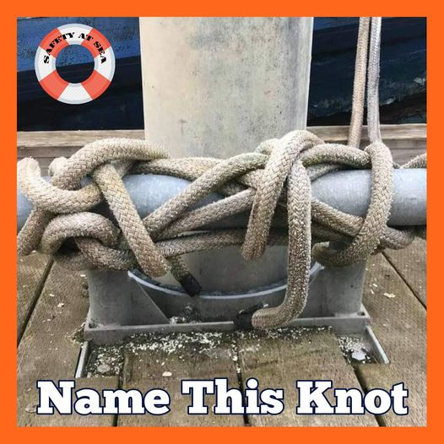
Belaying a cleat

Slide 5
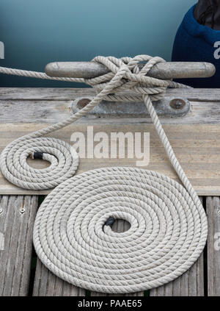
Dock Line Etiquette

Slide 6
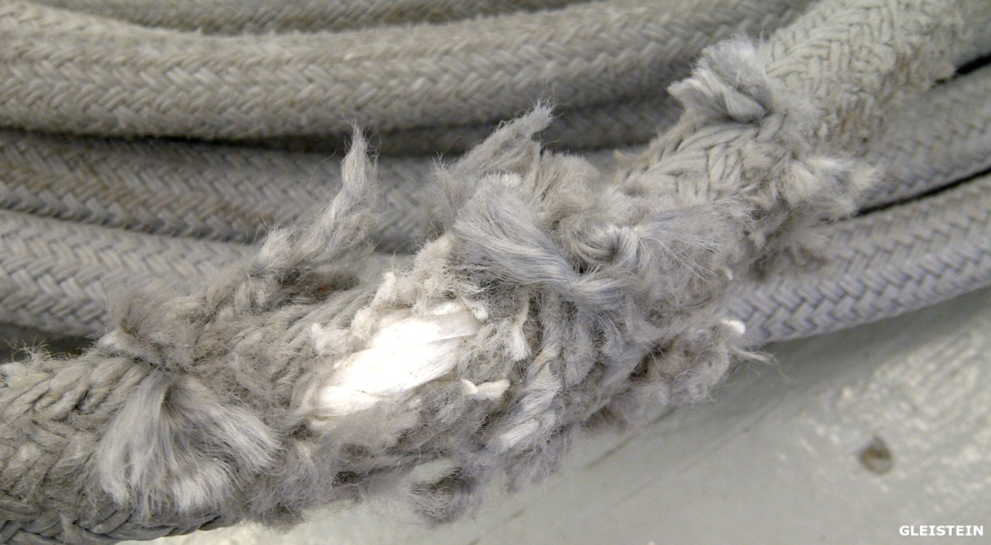
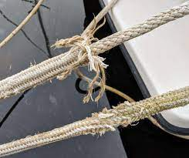
Chafe

Slide 7
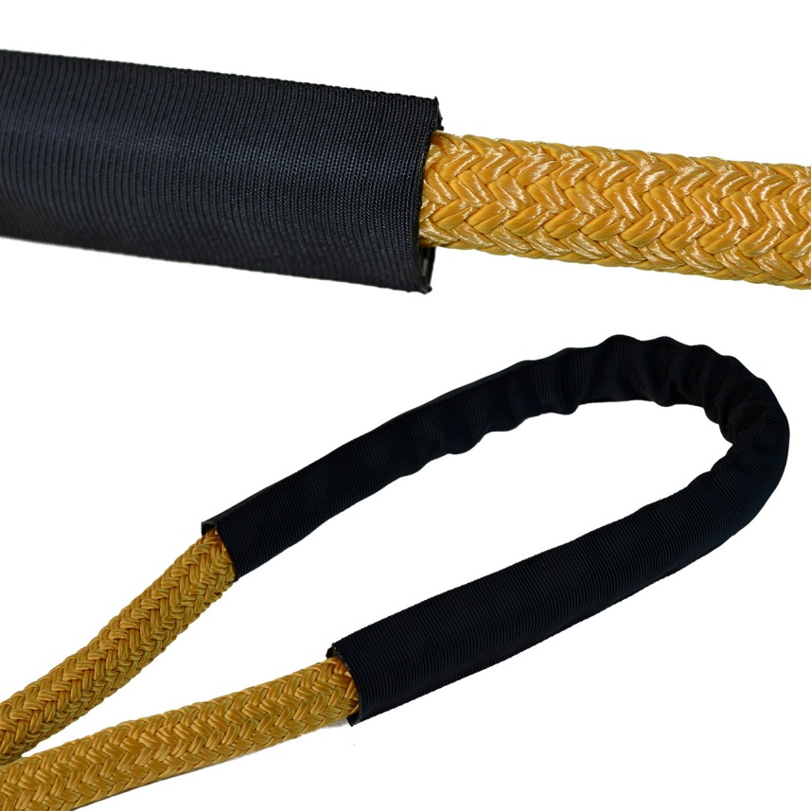
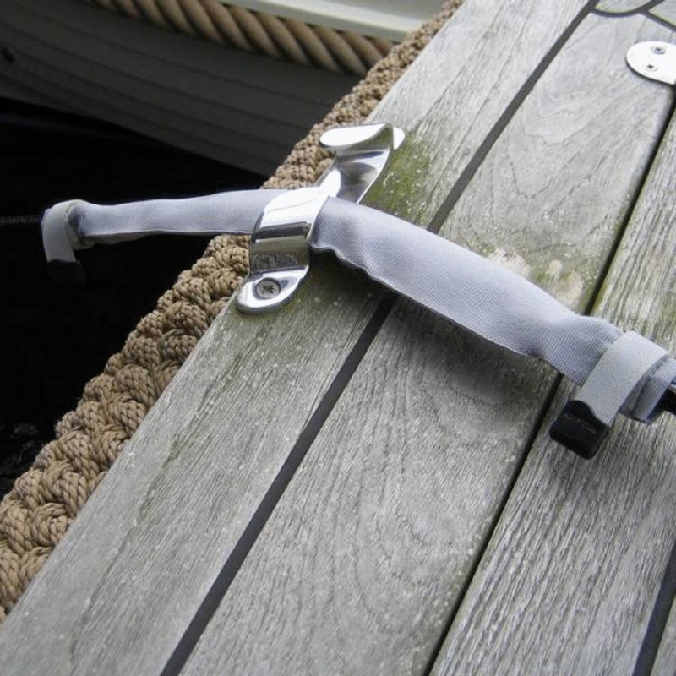
Chafe guard

Slide 8
END for END
If you use a line in the same function for several years it may develop wear or chafe at jammers or fairleads.
Same line...flip flop!
You may have to cut off a knot or eye splice.

Slide 9
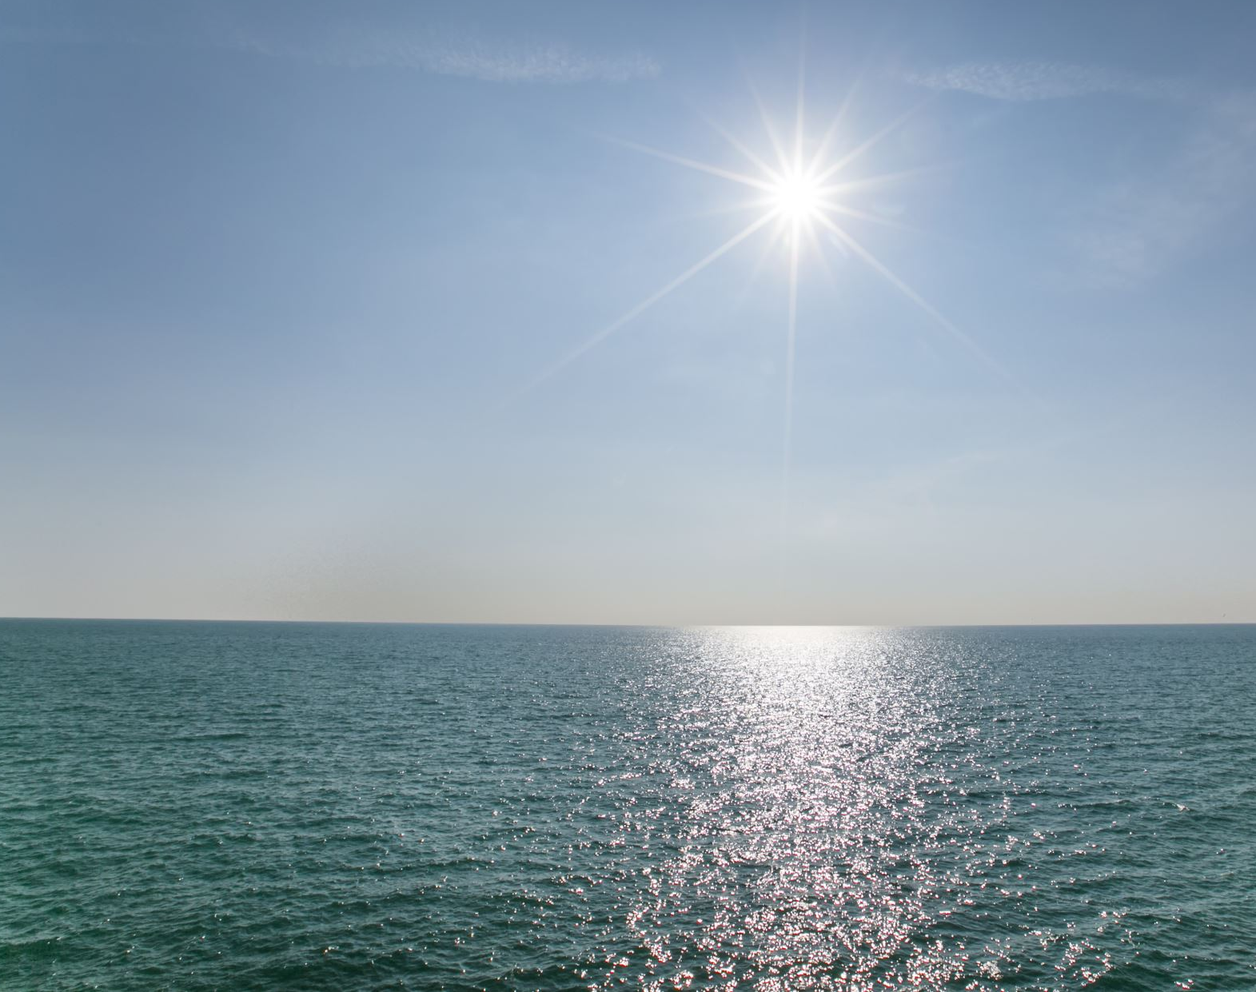
Lake Erie the kingdom of the SEICHE
Lake Erie is known for seiches, especially when strong winds blow from southwest to northeast. In 1844, a 22-foot seiche breached a 14-foot-high sea wall killing 78 people and damming the ice to the extent that Niagara Falls temporarily stopped flowing. As recently as 2008, strong winds created waves 12 to 16 feet high in Lake Erie, leading to flooding near Buffalo, New York.

Slide 10
A rope is just a rope...until it gets a job!
A rope tied to your jib clew becomes a sheet line.
Since you generally have two jib or genoa sheets one is working and the other is called lazy.
A rope connected to your mainsail control system is called a main sheet.
A rope that is used to raise your sail up the mast becomes a halyard.
A rope that is used to lower and secure the leach of your mainsail is a reef control line (you may have two or three of these).
A rope that tightens the foot of your mainsail is called an outhaul.
A rope that pulls the lower portion of your mainsail at the leach is called a flattening reef.

Slide 11
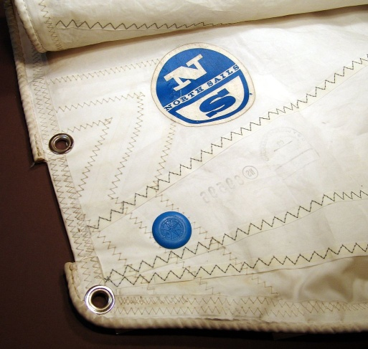
A rope that tightens the luff of your mainsail is called a cunningham
A rope that is part of a backstay tensioning system is called a backstay tensioner.
Symetrical spinnackers are controlled by two lines. The flying clew is controlled by a spinnaker sheet and the tack connected to the pole is called the guy. These names change as the spinnaker is jibed.
Ropes that form a catch net for mainsail lowering are called lazy jacks.
Ropes that are attached to a mainsail and are used to collect and hold the loose portion of a reefed mainsail are called reef lines.
A rope used to tow your dinghy is called a painter.
Ropes that are called ropes...Bolt rope
….Tow rope
….Rope ladder

Slide 12
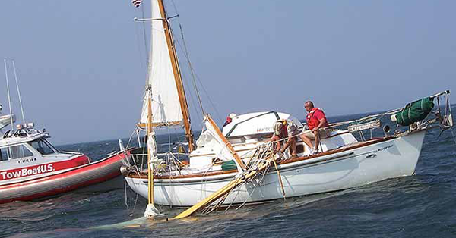
Wire Rope Standing rigging

Slide 13
Knots
Types:
Knots....tied at the end of the same line
Hitch...ties around or to something
Bend...joining two pieces of line together
Working end...where the knot happens
Standing part....part of the rope not being used.
Bight..rope doubled over on its self

Slide 15
Bowline

Slide 17
Bowline on a bight

Slide 20
Clove Hitch

Slide 21
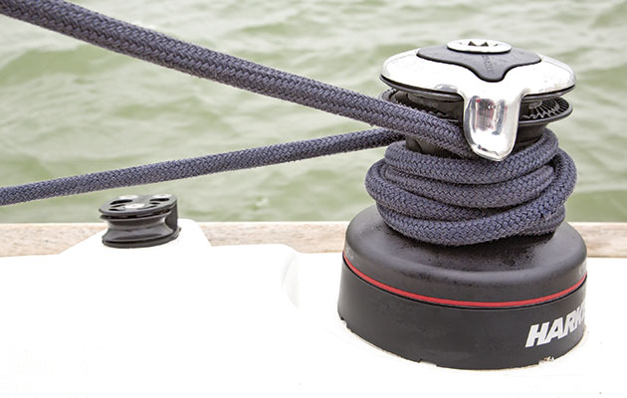
"line over"
Jammed winch

Slide 22
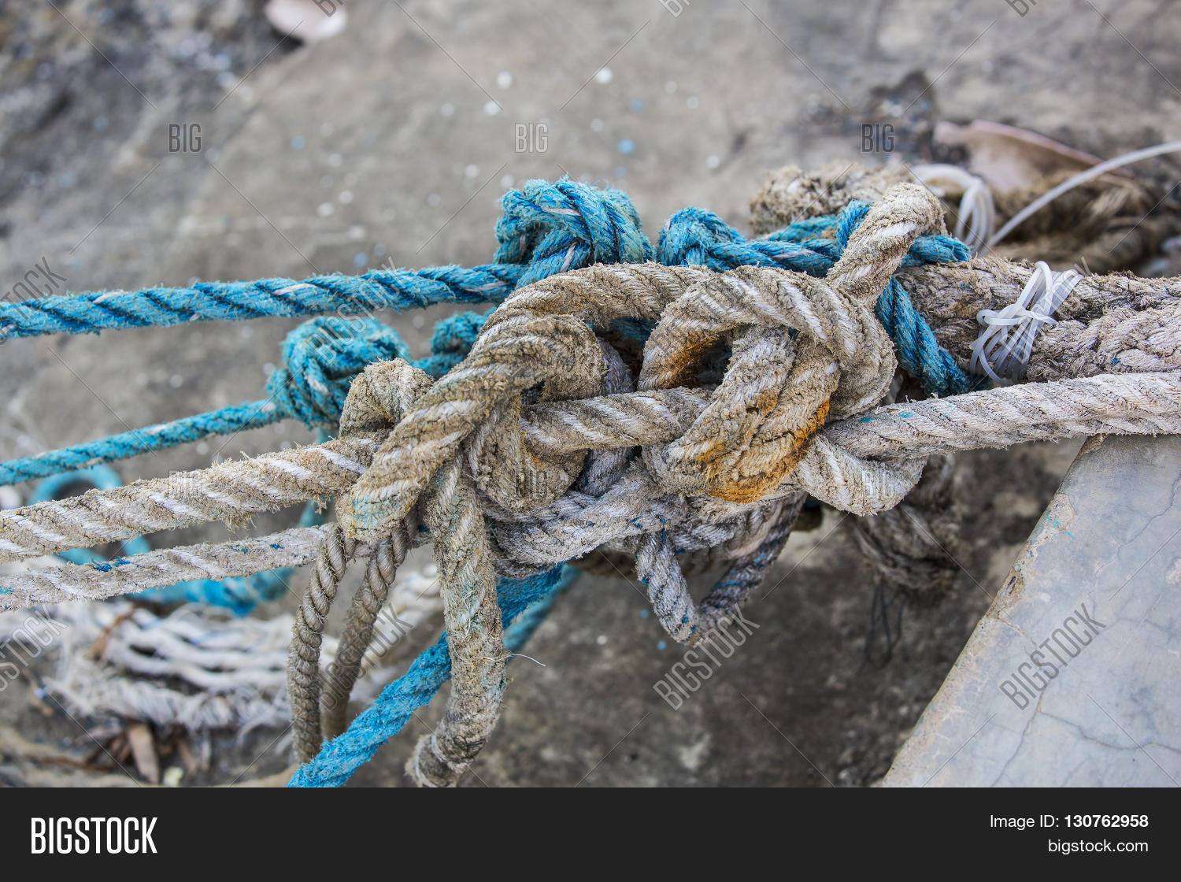
Rule of thumb:
If you can't tie a proper knot ….tie lots!

